Slide 1
FTC Programming Class
Session 3

Slide 2

Topics for today
Using Servos
Using Distance Sensors
TensorFlow Beta – Implementation
Code Walkthrough

Slide 3
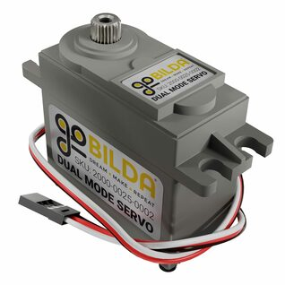
Servos
Servos provide precise rotational movements, with limited total rotation
Typically 180 degrees
(note, some servos can do continuous rotation, like a motor)

Slide 4
Typical Servo Applications
Last year’s robot used two servos:
The “Wobble Gripper” (servo opened and closed the wobble grip “hand”)
The “Shooter Flicker” (servo pushed each ring in the shooter into the rotating wheel assembly)
Servos are ideal for small precise movements
Smaller and lighter than motors

Slide 5
Limitations of servos
Servos have some key limitations:
Relatively slow movement speed
Torque limitation – easily damaged
Single-ended bearing – easily damaged

Slide 6
Programming Servos
private Servo shooterServo;
The entire range (about 180 degrees) of rotation on a servo is defined by numbers between 0 and 1.
For example, the mid-point of rotation is defined by a setting of .50
General steps to use a servo:
Declare the servo at beginning:
private Servo shooterServo;
Initialize the servo:
shooterServo = hardwareMap.servo.get("shooterServo");
To rotate to mid point:
shooterServo.setPosition(0.43);

Slide 7
Servo tips and tricks
Since servos are relatively slow, you may need to pause your next step in your robot action to allow time for the servo to move
Example:
wobbleServo.setPosition(.45); // Close wobble servo to release wobble
sleep(150);
It is hard to remember what specific servo values mean in your application. It is best to define what it does as a variable, and use that in your code
public double wgripOpen = .15;
public double wgripClosed = .45;
wobbleServo.setPosition(wgripClosed); // Close wobble servo to release wobble

Slide 8
Distance Sensors
Function of a Distance Sensor:
Measure and Report distance from the sensor to another object or wall
Example: Last season, we used two sensors to pick up the second wobble goal
One sensor measured the side distance to wall
The other measured the front distance to wall
Program moved robot to align robot with the location of the wobble using info from the distance sensor
General steps to use a distance sensor:
Declare the distance sensor at beginning:
ModernRoboticsI2cRangeSensor rightDistance;
Initialize the sensor:
rightDistance = hardwareMap.get(ModernRoboticsI2cRangeSensor.class, "rightDistance");
To get distance:
rightDist = rightDistance.getDistance(DistanceUnit.INCH);

